Slide 1
Final Presentation
Dylan Queen

Slide 2
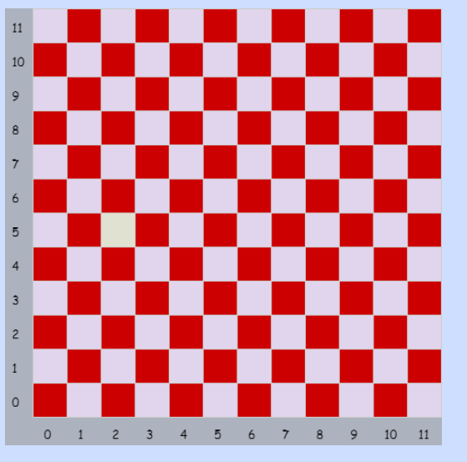
Patterns

Slide 3
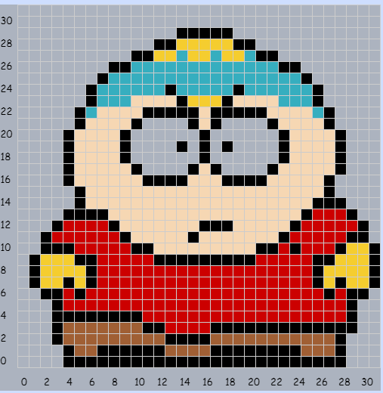
Pixel art

Slide 4
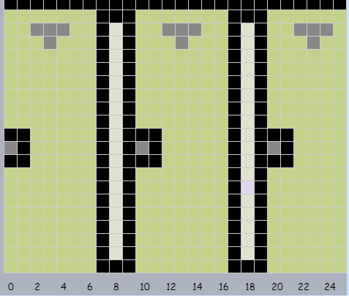
Objects in bryan

Slide 5
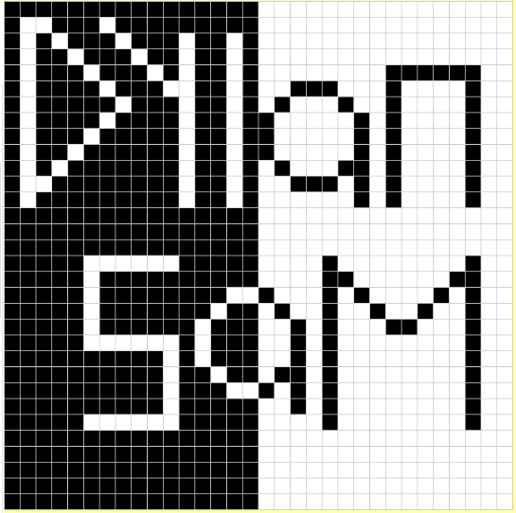
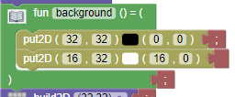
Name Project
Backround code
Half black
Half white

Slide 6
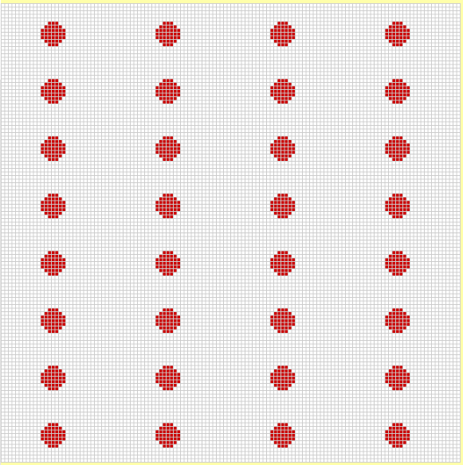
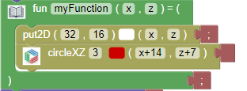
Flag Project
My function
The first logo
Repeated after

Slide 7
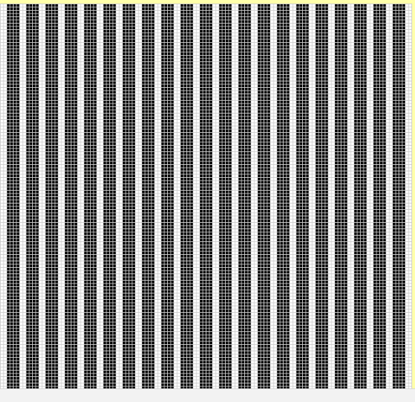
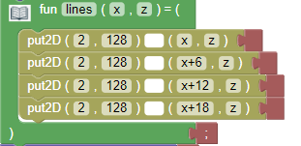
More patterns
The white lines
Over a black backround

Slide 8
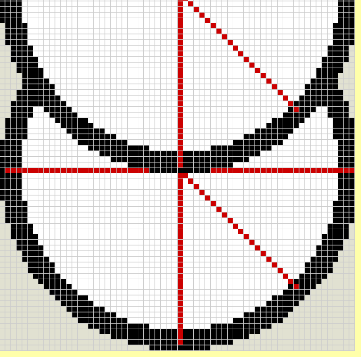
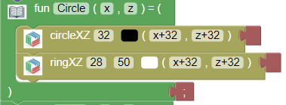
All Functions part 1
First circle
Repeated later on

Slide 9
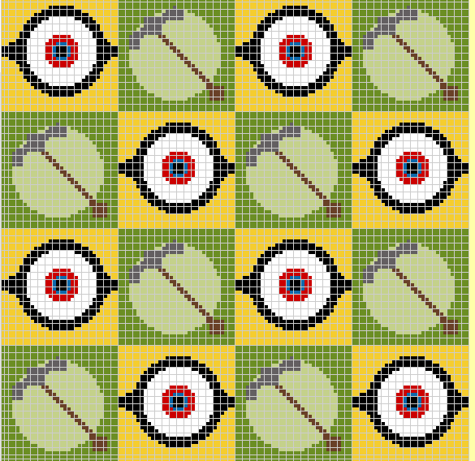
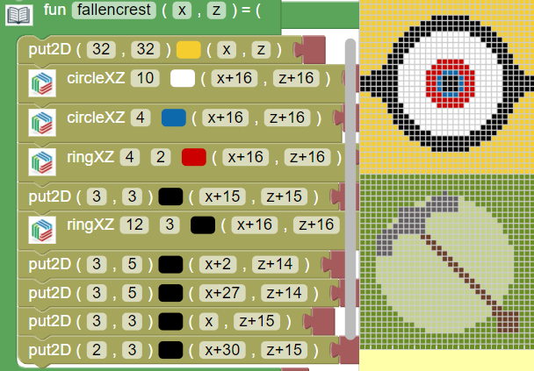
All functions Part 2

Slide 10
All functions part 3
Its very easy
Once he made the first 2 I just copied pasted myfunctions to get the full thing

Slide 11
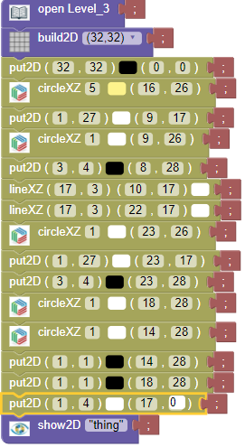
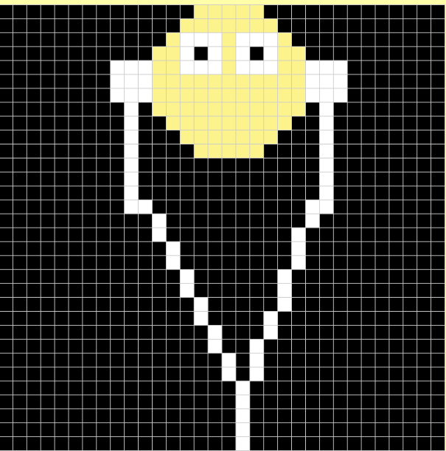
Real image
Its simple
The white circles are the eyes and the ear buds
The black put 2Ds are to cover some of the extra and they are the eyes
Everything else is the cords and the head shape

Slide 12
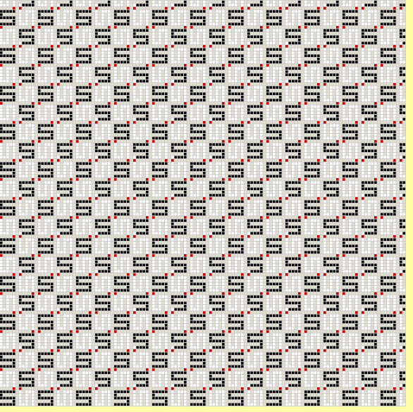
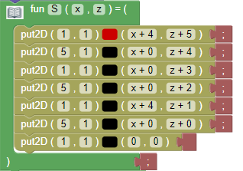
Space filling curves
it’s the Black S variable
With the red dot
I make it into rows later on and its repeated

